Slide 1

Neural Network
BISSIT 2021
Michal Hradiš - Brno University of Technology

Slide 2
Where to get more information
Ian Goodfellow and Yoshua Bengio and Aaron Courville: Deep Learning, MIT Press, 2016.
Andrew Ng and Kian Katanforoosh: CS230 Deep Learning, Stanford,
CS231n: Convolutional Neural Networks for Visual Recognition, Stanford,
Andrew Ng, CS229 Machine Learning, Stanford. Youtube
CS224N: Natural Language Processing with Deep Learning
CS236: Deep Generative Models
Deep Reinforcement Learning

Slide 3
Frameworks
Pytorch tutorials - https://pytorch.org/tutorials/
Tensorflow

Slide 4

What are neural networks?
One of existing machine learning algorithms
Complex and flexible functions (could be computationally expensive)
Can learn to approximate a desired function from training data
Can accept large range of input types and produce large range of output types
Can be “customized” to solve very different tasks.
8

Slide 5
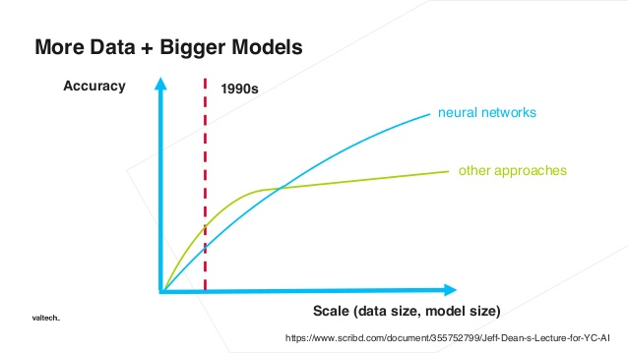
Why?
Scales with computation
Scales with data
General framework
State of the art
Massive development
Mature tools

Slide 6
What is a neural network? (in this lecture)
Numerical output vector f(x)
Numerical input vector (x)
0.1
0.2
0.5
0.6
0.2
0.6
0.1
0.3
Neural Network
0.5
1.2
3
2
1
2
0
f(x; θ)

Slide 7
Binary classification network
Features (x)
Probability of a granade
P(granade|x)
Weight 0.1
Red 0.2
Size 0.5
Neural Network
e.g. logistic regression
0.95
f(x; θ) = sigmoid(wx + b)

Slide 8
Binary classification network
Features
Probability of a granade
P(granade|x)
Weight 0.1
Red 0.2
Size 0.5
Neural Network
e.g. logistic regression
0.95
f(x; θ) = sigmoid(wx + b)
Training: tune parameters θ = {w, b}

Slide 9



Training
Ground truth
Model
Input
f(x; θ) = sigmoid(wx + b)
Loss
Optimization
algorithm
Parameter Gradients

Slide 10



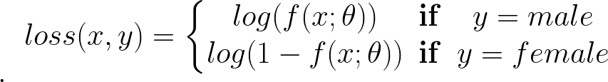
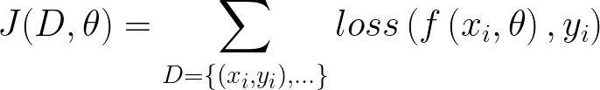
Supervised learning components
Training data - inputs and desired network outputs
Model with parameters (network)
Loss function (e.g. cross entropy)
Objective function
D = {( , ), ( , ), ( , ), ( , )}
f(x; θ) = sigmoid(wx + b)

Slide 11
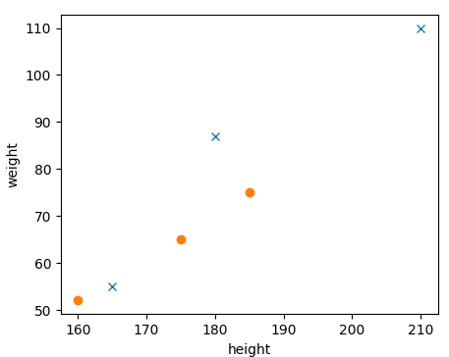
Data - example
Height | Weight | Sex
180 | 87 | 0
210 | 110 | 0
160 | 52 | 1
175 | 65 | 1
165 | 55 | 0
185 | 75 | 1

Slide 12
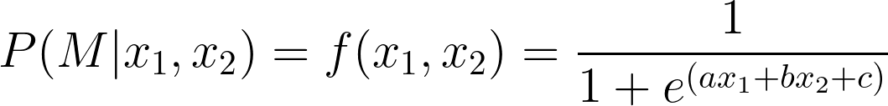
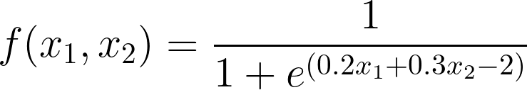
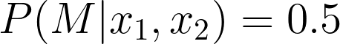
Model Example
Height (x₁) | Weight (x₂) | Sex (y)
180 | 87 | F
210 | 110 | F
160 | 52 | M
175 | 65 | M
165 | 55 | F
185 | 75 | M
Male
Female
Notes:
P(M|x_1, x_2) = f(x_1, x_2) = \frac{1}{1+e^{(a x_1 + b x_2 + c)}}

Slide 13
Model Example
Height (x₁) | Weight (x₂) | Sex (y)
180 | 87 | F
210 | 110 | F
160 | 52 | M
175 | 65 | M
165 | 55 | F
185 | 75 | M
Male
Female
Notes:
P(M|x_1, x_2) = f(x_1, x_2) = \frac{1}{1+e^{(a x_1 + b x_2 + c)}}

Slide 14
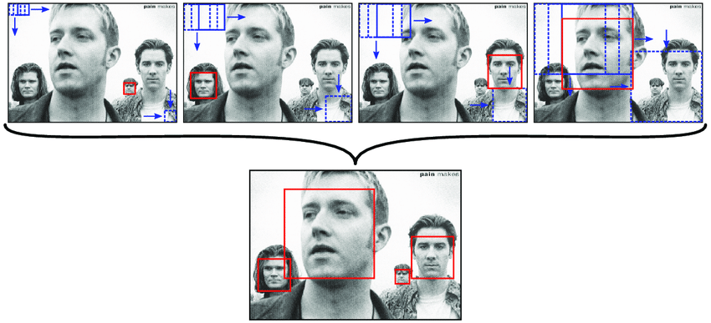
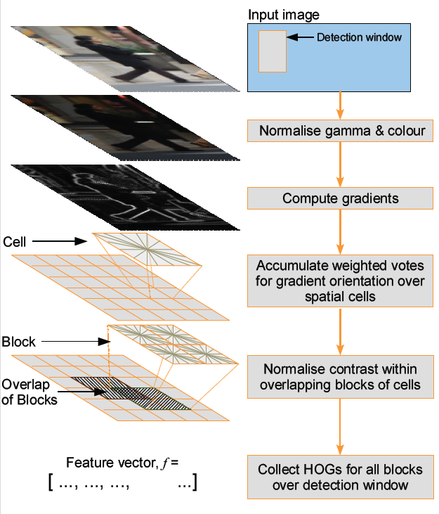
“Shallow” learning
f([features]; θ) = sigmoid(w[features] + b)
N. Dalal, and B. Triggs. Histograms of Oriented Gradients for Human Detection. In Proc. CVPR, 2005.
Šochman. Learning for Sequential Classification. Thesis, CMP, 2009.

Slide 15
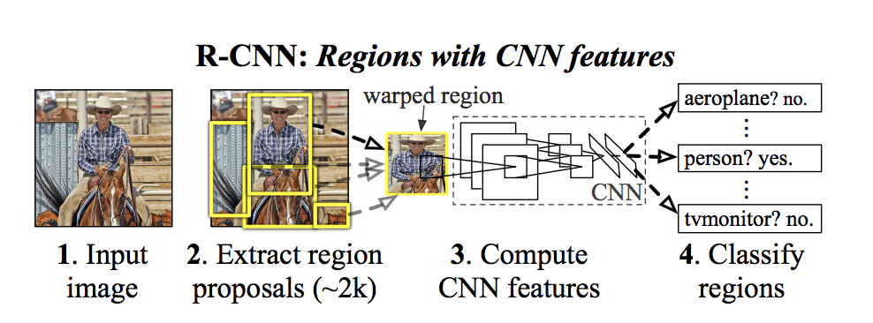
Deep learning
No hand coded feature extraction
Our domain knowledge goes into network architecture, regularization, loss, data augmentation, ...
Girshic et al.: Rich Feature Hierarchies for Accurate Object Detection and Semantic Segmentation. CVPR, 2014.

Slide 16
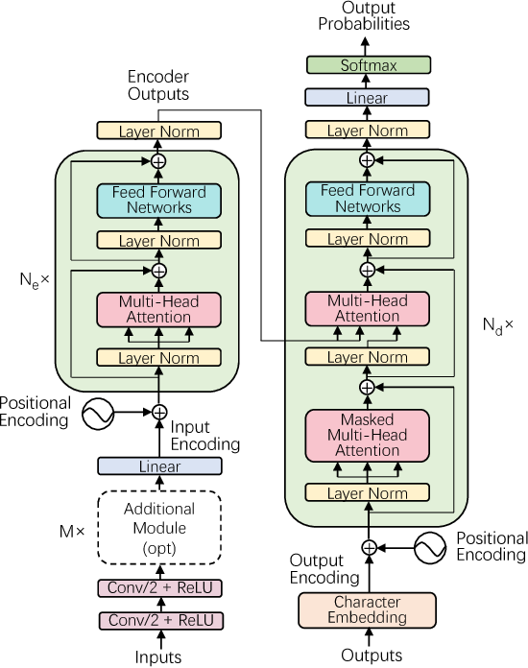
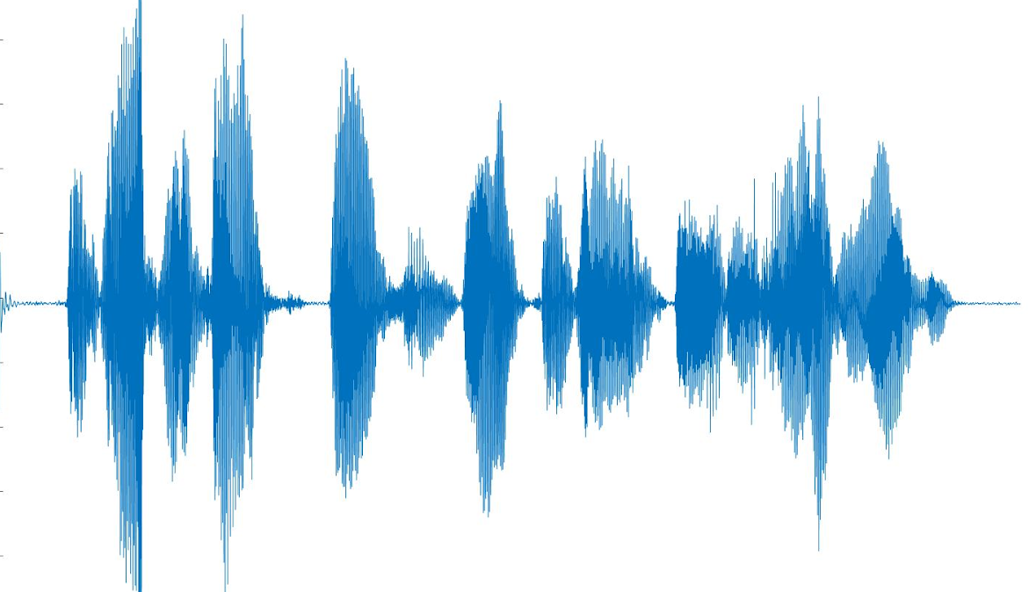
End to end speech recognition/translation
Honza šel na jahody
Dong, L., Xu, S., & Xu, B.. Speech-Transformer: A No-Recurrence Sequence-to-Sequence Model for Speech Recognition. ICASSP, 2018.

Slide 17
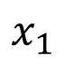
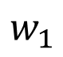
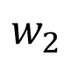
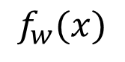
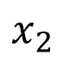
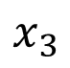
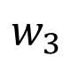
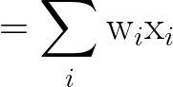
Neural network components (neurons)

Slide 18
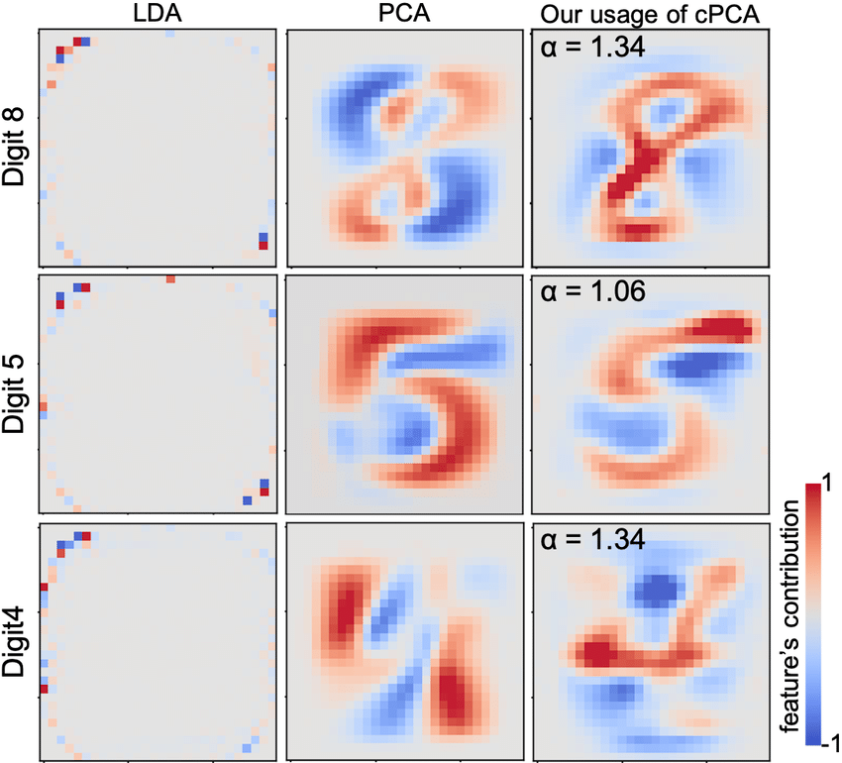
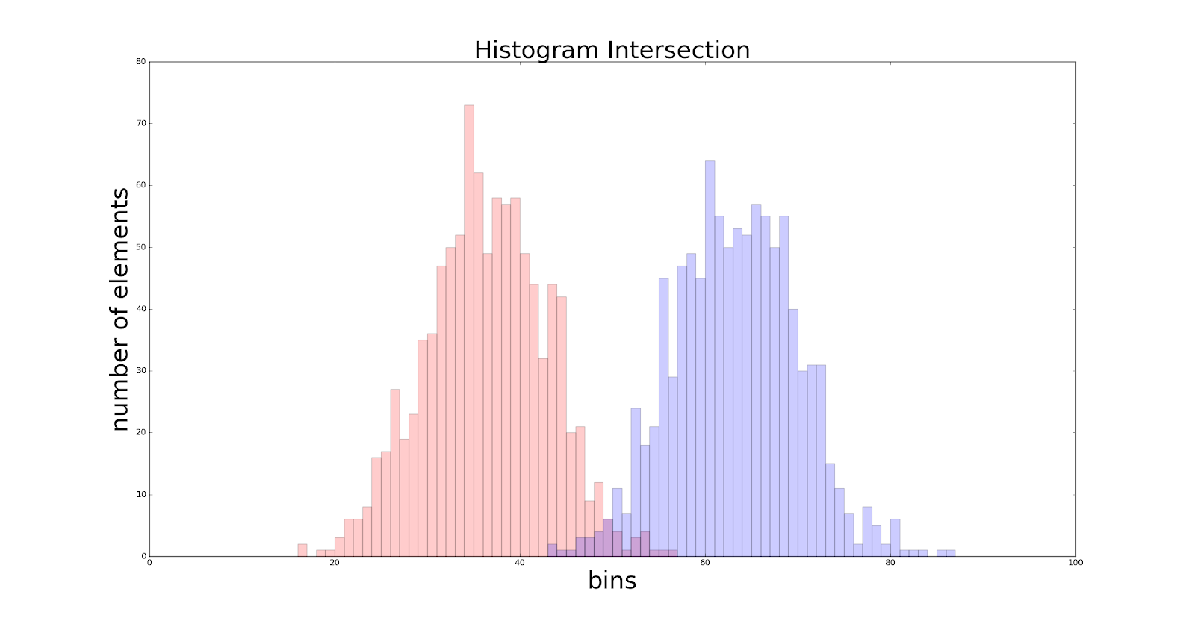



Neurons as templates
Neurons have higher activations if the input “matches” their weights.
*

Slide 19
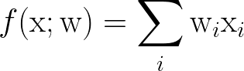
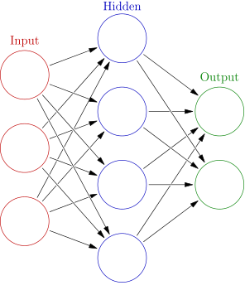
Composition of linear functions?

Slide 20
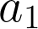
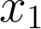
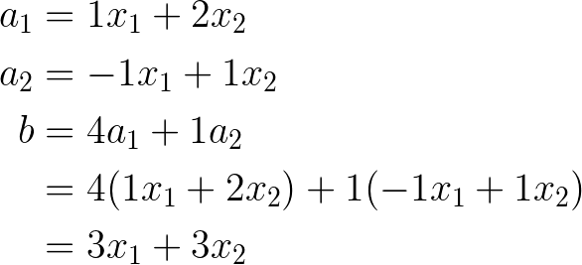
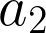
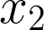
Composition of linear functions?

Slide 21
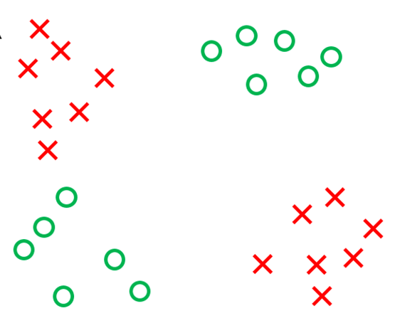
Linear separability and composition of functions

Slide 22
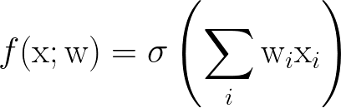
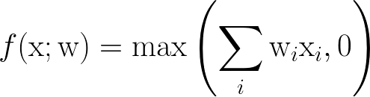
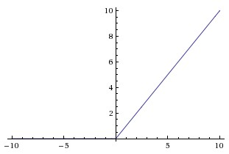
Non-linearity (more at https://en.wikipedia.org/wiki/Activation_function)
Non-linearities mostly process each activation independetly.
One example is ReLU (rectified linear. unit).

Slide 23
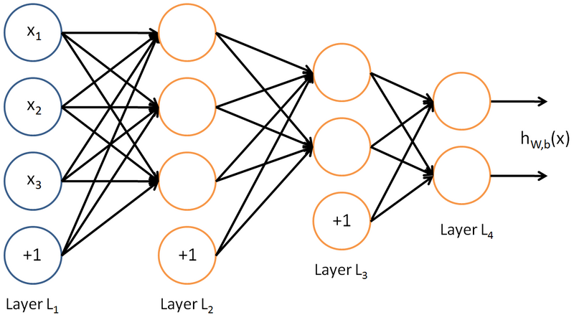
From neurons to layers
Source: UFLDL tutorial, http://ufldl.stanford.edu/wiki/index.php/UFLDL_Tutorial

Slide 24
From neurons to layers
Source: UFLDL tutorial, http://ufldl.stanford.edu/wiki/index.php/UFLDL_Tutorial

Slide 25
Layers
Often, we don’t visualize the layers, but their inputs and outputs (activations).
x
L₁
L₂
L₃
Source: UFLDL tutorial, http://ufldl.stanford.edu/wiki/index.php/UFLDL_Tutorial

Slide 26
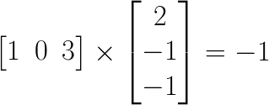
From neurons to matrices
We would like to define layer of neurons as single mathematical operation (as a linear layer).
Solution: Linear algebra

Slide 27
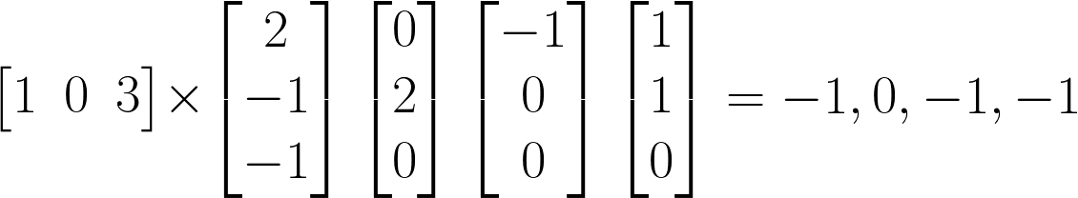
Linear layer

Slide 28
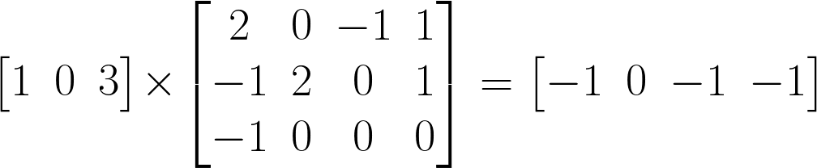
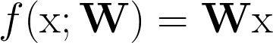
Linear layer as matrix multiplication

Slide 29
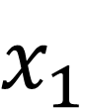
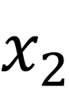
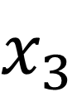
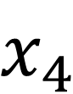
Neural network in code

Slide 30
Loss functions
During training, loss function measures how network output differs from the desired output.
It is important to use the correct loss function for the task.
It is important to use correct activation function for the taks.
Multiple loss/activation pairs can usually be used for a single task, but choice affects, what the network learns. (You change the taks definition.)

Slide 31
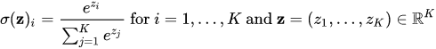
Outputs and loss functions
Regression: Linear - MSE, absolute differences
Binary Classification: Sigmoid - cross-entropy
Multi-class Classification: Softmax - cross-entropy

Slide 32

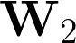
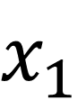
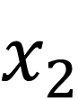
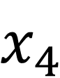
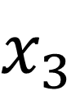
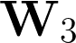
Computational graph
dot
max
dot
max
max
dot

Slide 33
Computational graph
dot
dot
max
dot
max
max
dot

Slide 34
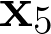

Computational graph
dot
dot
max
dot
max
max
dot
dot

Slide 35

Training of neural networks

Slide 36


Gradient Descent

Slide 37

Derivatives

Slide 38



Gradients for training - chain rule
Need
w₂
1
*
+
2
*
-
(z)²
w₁
3
Notes:
\nabla_w J = \left[ \frac{\partial J}{\partial w_2}, \frac{\partial J}{\partial w_2} \right ]
\frac{\partial (w_1+ 2w_2 - 3)^2}{\partial w_1} = \frac{\partial (a)^2} {\partial a} \, \frac{\partial (b-3)}{\partial b} \, \frac{\partial (c + 2w_2)}{\partial c} \, \frac{\partial (1 * w_1)}{\partial w_1}
\frac{\partial (w_1+ 2w_2 - 3)^2}{\partial w_2} = \frac{\partial (a)^2} {\partial a} \, \frac{\partial (b-3)}{\partial b} \, \frac{\partial (w_1 + c)}{\partial c} \, \frac{\partial (2 * w_2)}{\partial w_2}

Slide 39






Gradient for training
Need
w₂
1
*
+
2
*
-
(z)²
w₁
3
Notes:
\nabla W = \left[ \frac{\partial J}{\partial w_2}, \frac{\partial J}{\partial w_2} \right ]
\frac{\partial (1w_1+ 2w_2 - 3)^2}{\partial w_1} = \frac{\partial (a)^2} {\partial a} \, \frac{\partial (b-3)}{\partial b} \, \frac{\partial (c + 2w_2)}{\partial c} \, \frac{\partial (1 * w_1)}{\partial w_1}
\frac{\partial (1w_1+ 2w_2 - 3)^2}{\partial w_2} = \frac{\partial (a)^2} {\partial a} \, \frac{\partial (b-3)}{\partial b} \, \frac{\partial (1w_1 + c)}{\partial c} \, \frac{\partial (2 * w_2)}{\partial w_2}

Slide 40

Full training / stochastic algorithms
Forward pass
Compute loss
Backward pass
Compute derivatives of objective fce with respect to net. parameters using chain rule / backpropagation
Update parameters

Slide 41
Stochastic/mini-batch gradient descent
Large datasets -> too much computation per network update -> inefficient training
Estimate gradients on a small random part of the training set (mini-batch) and update network
Stochastic Gradient Descent
mini-batch=
Gives approximate
D=
Gives exact

Slide 42
Train good model and guess real-world performance
Training set
Train models on this set
In domain data, similar problems, synthetic, generated, augmented
Validation set
Evaluate models, tune hyperparameters, choose alg. and architecture
Same (iid) as training set?
Test set
Estimate real-world performance
Data ideally from real world
Loss is usually different than the target metric
Loss can improve while “accuracy” gets worse

Slide 43

Data in neural networks
Batch of vectors - 2D tensor {B, C}
Batch of sequences - 3D tensor {B, t, C} / {B, C, t}
Batch of images - 4D tensor {B, H, W, C} / {B, C, H, W}

Slide 44
Pytorch introduction / basics of tensors
https://colab.research.google.com/drive/1cHv9lB3cUWjyFrTQXiXtOWgxETFLXeQW
The same as Numy with
Automatic differentiation
GPU support
Neural network layers
Loss functions
Optimization algorithms for neural networks
Datasets, data augmentation, predefined networks, pretrained network, ...

Slide 45

Neural networks for structured data

Slide 46

Local cues

Slide 47

Local cues

Slide 48


Image representations

Slide 49
Layers for images?
Which mathematical operation fits?
Is local
Processes each part of input the same way
Is linear
Is the building block of neural networks for images, sound, ...

Slide 50
History of Convolutional Networks
1980 – Kunihiko Fukushima – Neocognitron: A Self-organizing Neural Network Model for a Mechanism of Pattern Recognition Unaffected by Shift in Position
1986 – Hinton, Rumelhart, Williams, McClelland - Backpropagation
1998 – LeCun et al.: Gradient-Based Learning Applied to Document Recognition
2012 – Krizhevsky et al.: ImageNet Classification with Deep Convolutional Neural Networks
2013-today – explosion of applications

Slide 51



Convolution
Linear operation
(matrix multiplication on small neighborhood)
Output: Map of local similarity of input and conv. kernel
Image from:Basavarajaiah. 6 basic things to know about Convolution. https://medium.com/@bdhuma/6-basic-things-to-know-about-convolution-daef5e1bc411

Slide 52

Convolutional layer

Slide 53
Convolutional layer
Image from:Basavarajaiah. 6 basic things to know about Convolution. https://medium.com/@bdhuma/6-basic-things-to-know-about-convolution-daef5e1bc411

Slide 54

Convolutional layer
+
Image from:Basavarajaiah. 6 basic things to know about Convolution. https://medium.com/@bdhuma/6-basic-things-to-know-about-convolution-daef5e1bc411

Slide 55


Convolution
Channels -> activation map
Image from:Basavarajaiah. Vasudevan, Aravind et al. “Parallel Multi Channel convolution using General Matrix Multiplication.” ASAP. 2017.

Slide 56

Pooling layer
Downsampling
Local pixels are aggregated into a single pixel
Spatial resolution is reduced, channels stay the same
Reduction by AVERAGE or MAX functions.
MAX-pooling directly encourages translation invariance
Image from: Yani et al., Application of Transfer Learning Using Convolutional Neural Network Method for Early Detection of Terry’s Nail. J. Phys. Conf. 2019.

Slide 57

Network architecture (VGG net)

Slide 58

Hierarchy of features
(and human visual system analogy)
Low-level features
Mid-level features
High-level features

Slide 59

Very Deep Convolutional Networks
Karen Simonyan, Andrew Zisserman: Very Deep Convolutional Networks for Large-Scale Image Recognition,

Slide 60


GoogLeNet
Szegedy et al.: Going deeper with convolutions

Slide 61

GoogLeNet - Inception Layer
Winner of ILSVRC 2014
Szegedy et al.: Going deeper with convolutions

Slide 62


Residual networks

Slide 63

Combinations

Slide 64
Generalization
Deep convolutional networks overfit surprisingly late
Good model structure
Multi-task learning
Pre-training
Domain adaptation
More data - augmentation, synthetic data
Model size

Slide 65

Regularization and overfitting
Deep convolutional networks overfit surprisingly late
Early stopping (when training)
Weight regularization (weight decay)
does not help much (with ReLU)
Activation regularization
Dropout helps a lot
Sets random activations to 0
Notes:
J(D,\theta)= \left( \sum_D loss(f_\theta(x_i), y_i)\right) + \lambda||\theta||^2

Slide 66

Data augmentation

Slide 67
Finetuning
Probability of mushroom being poisonous
Network pre-trained on a large general dataset (ImageNet)
New layer (s)

Slide 68

Batch normalization
Ioffe, Szegedy: Batch normalization: accelerating deep network training by reducing internal covariate shift, ICML, 2015.

Slide 69

Object detection
R-CNN
Girshick, R., Donahue, J., Darrell, T., & Malik, J., "Rich feature hierarchies for accurate object detection and semantic segmentation"

Slide 70


Fully Convolutional Networks: FCN

Slide 71


Pose estimation
Toshev et al.: DeepPose: Human Pose Estimation via Deep Neural Networks. CVPR 2014

Slide 72


Facial alignment
The same network as for poses
Sun et al.: Deep Convolutional Network Cascade for Facial Point Detection, CVPR 2013

Slide 73
Weird learning
Semi supervised learning
Active learning
Self-supervised learning
Transfer learning

